Slide 1
Object Oriented Programming using Java
SUKKUR IBA UNIVERSITY
Presented By:
Ghulam Mujtaba Shaikh

Slide 2
Java Variables and Datatypes

Slide 3
Agenda of this Lecture
Recap of the Last Lecture
Variables in Java
Datatypes in Java
Variable Naming Conventions
Java Keywords
Constant Variables
Variable Scope
Java Type Casting
Java Escape Sequences
Java Comments
Recap

Slide 4
Variables
Variables are container
  For Example: a = 10 ;
Variables are identifiers
  Uniquely identified in a program
  Unique memory location
Variables are changeable
  Can change the name. So, can replace a by x trough out the program

Slide 5
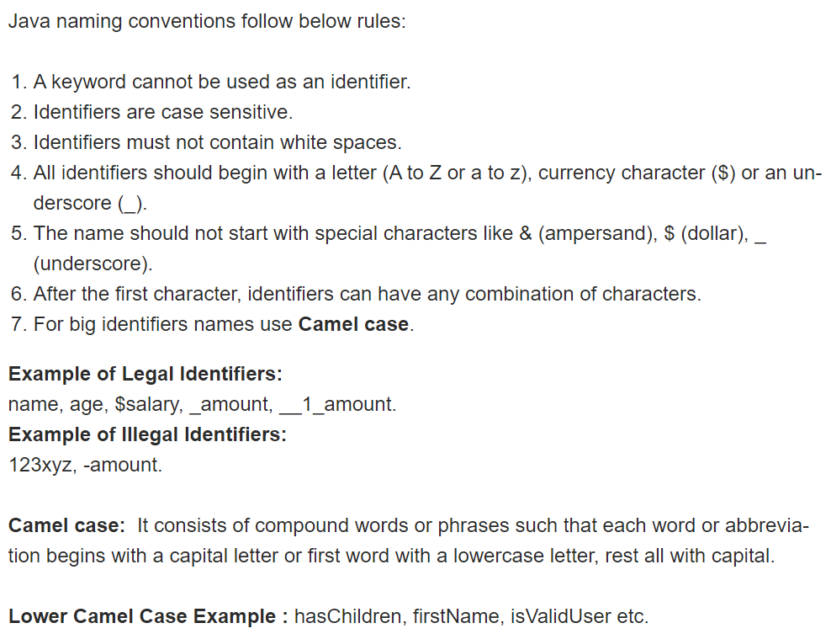
Variables Naming Convention

Slide 6
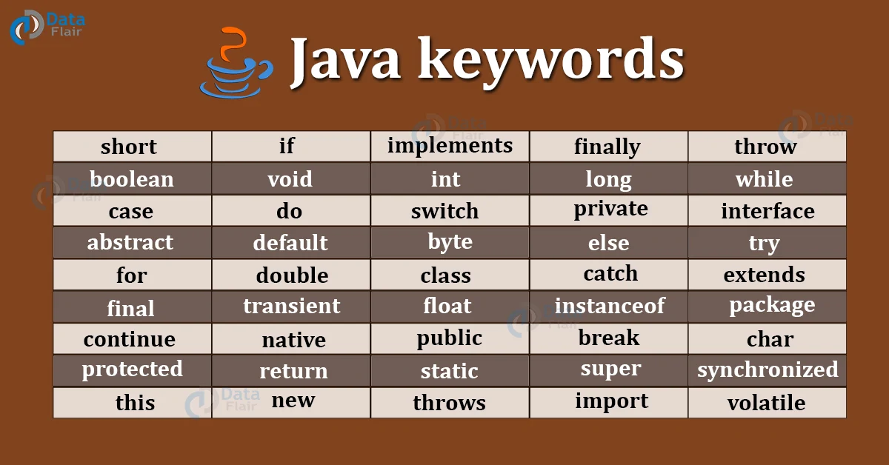
Variables Naming Convention

Slide 7
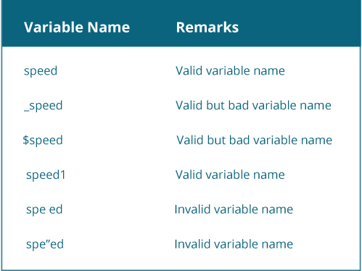
Variables Naming Convention

Slide 8
Datatypes
Which shows the types of data
  Numeric, decimal, character, wording, etc.
Primitive versus non-primitive datatype
Primitive data type: Which are built in java such as, float, int, char, Boolean, etc. These hold single value at a time.
Non-primitive datatype: Which user can create itself such as, arrays, array list, hash map, etc. These hold multiple values either in a contiguous or random location.

Slide 9
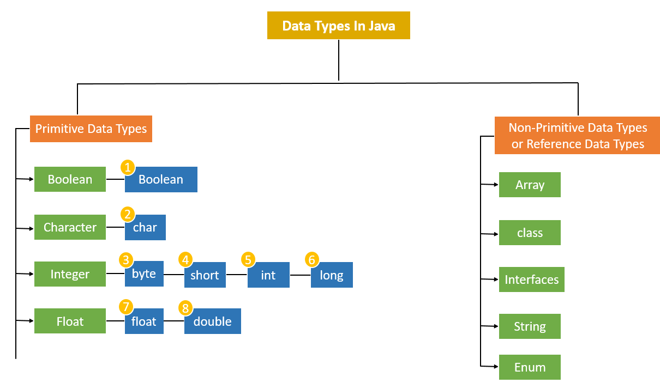
Datatypes

Slide 10
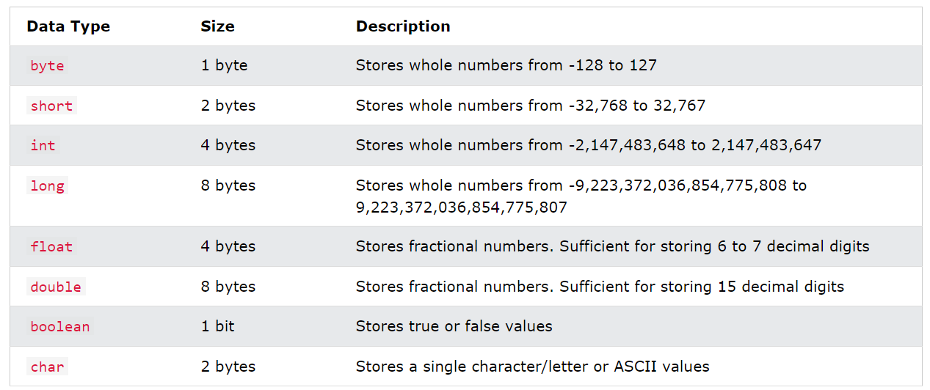
Primitive Datatypes

Slide 11
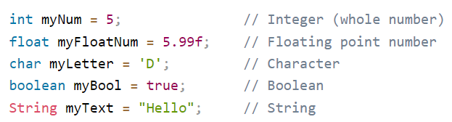
Primitive Datatypes
*** Countable versus Measurable Data
Countable : byte, short, int, long
Measurable: float, double

Slide 12
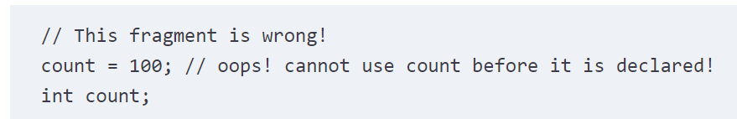
Datatypes
Variable Declaration
  int no_of_books;
Variable Initialization
  no_of_books = 35000 ;
Variable Definition
  int no_of_books = 35000 ;

Slide 13
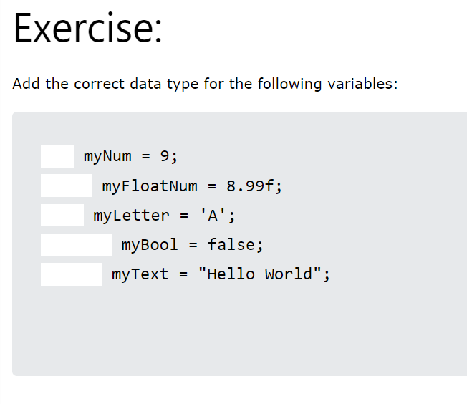
Datatypes

Slide 14
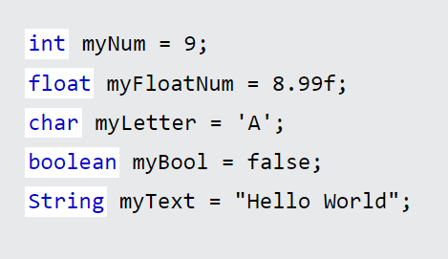
Datatypes

Slide 15
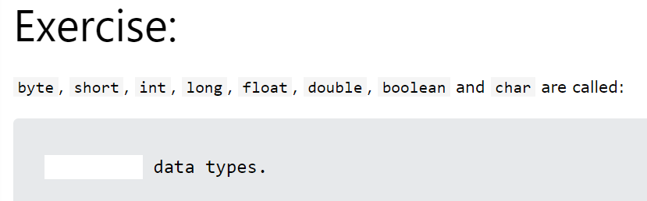
Datatypes

Slide 16
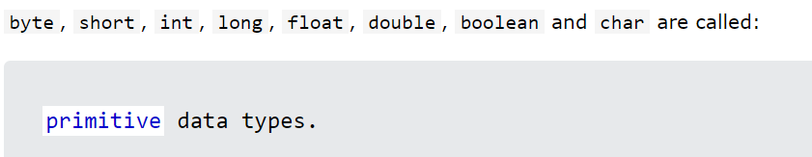
Datatypes

Slide 17
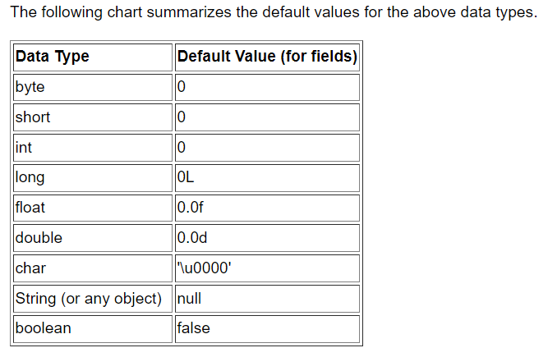
Datatypes

Slide 18
Final Variables
If you don't want others (or yourself) to overwrite existing values, use the final keyword (this will declare the variable as "final" or "constant", which means unchangeable and read-only).
Example:
  final double PI = 3.141 ; // this is ok
  PI = 1.2 ; // Error, you can not overwrite

Slide 19
Printing the Variables
The println() method is often used to display variables.
To combine both text and a variable, use the + character.
+ here is known as the concatenation operator.
Example:
String courseName = “OOP using Java";
System.out.println(“Welcome to " + name);

Slide 20
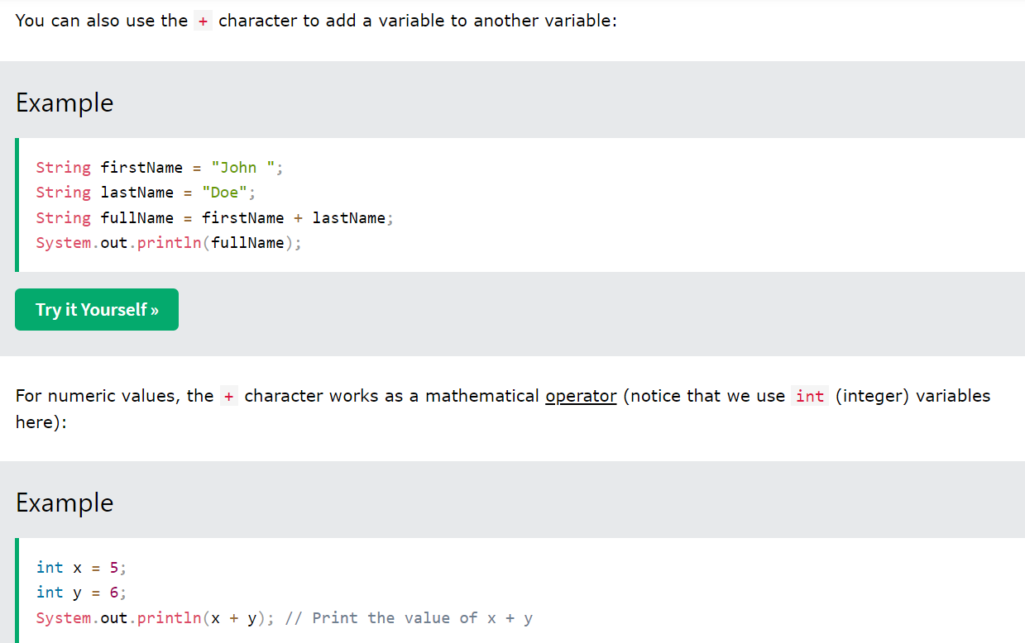
Printing the Variables

Slide 21
Printing the Variables

Slide 22
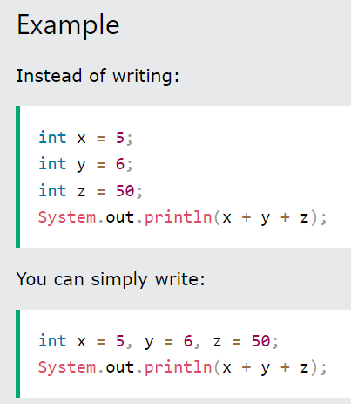
Declaring Multiple Variables
To declare more than one variable of the same type, you can use a comma-separated list:

Slide 23
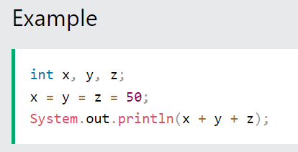
One Value to Multiple Variables
You can also assign the same value to multiple variables in one line:

Slide 24
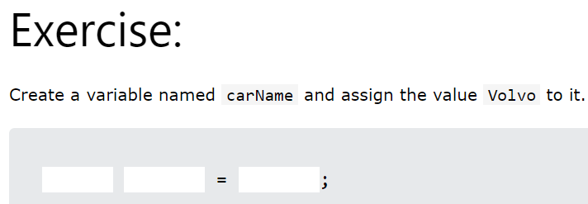
Wake Up!

Slide 25

Wake Up!

Slide 26
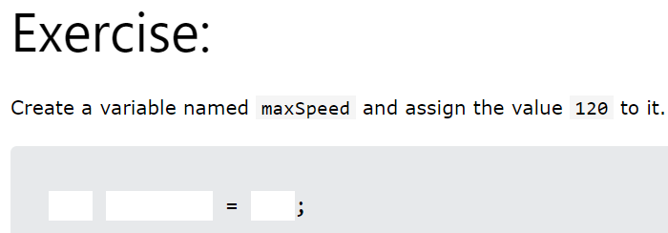
Wake Up!

Slide 27

Wake Up!

Slide 28
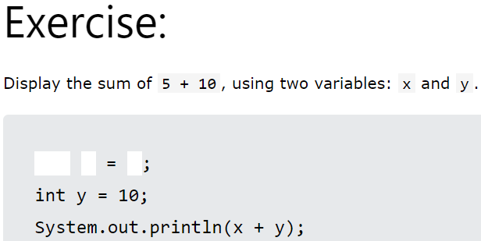
Wake Up!

Slide 29
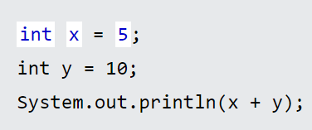
Wake Up!

Slide 30
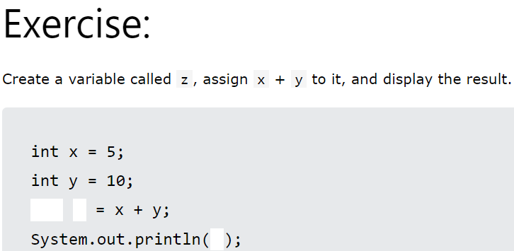
Wake Up!

Slide 31
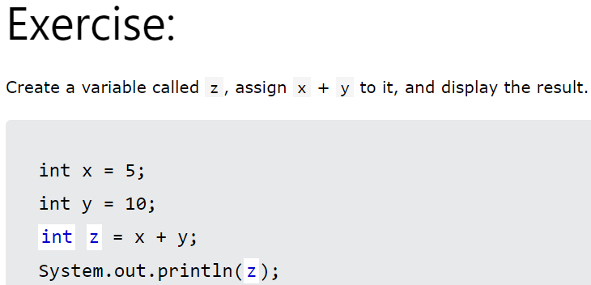
Wake Up!

Slide 32
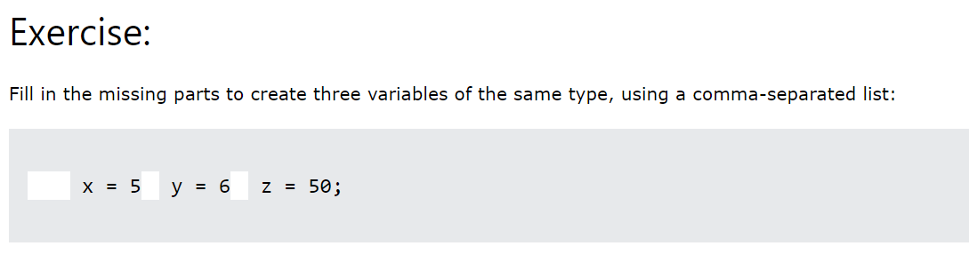
Wake Up!

Slide 33
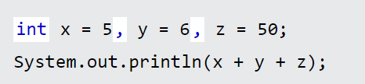
Wake Up!

Slide 34
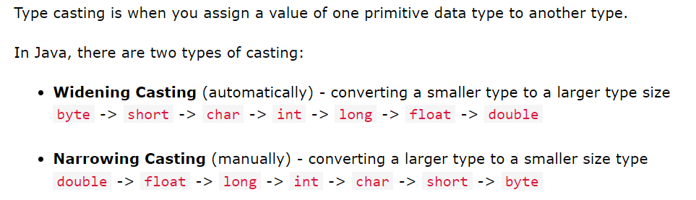
Java Type Casting

Slide 35
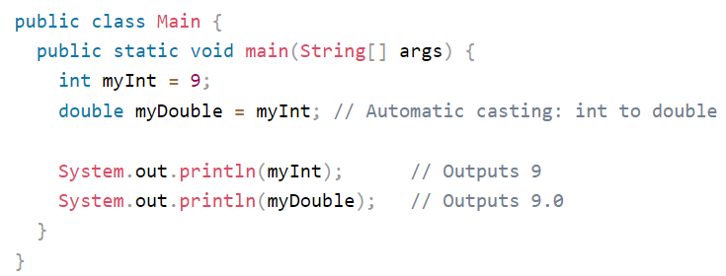
Widening | Implicit | Automatic Casting
Widening casting is done automatically when passing a smaller size type to a larger size type.

Slide 36
Widening | Implicit | Automatic Casting
Implicit cast is also called the automatic conversion or widening.
In implicit cast the two types are compatible.
In implicit cast, the destination type is larger than the source type.
For instance, int data type is compatible with short and byte data type.
Integer and floating values are also compatible to each other.
Numeric data types are not compatible with char or Boolean.

Slide 37
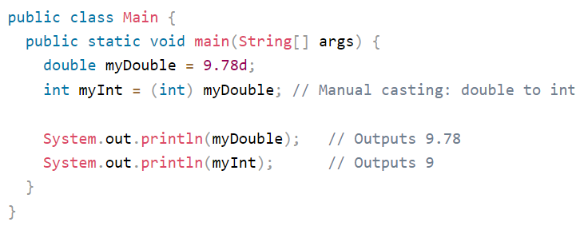
Narrowing | Explicit | Manual Casting
Narrowing casting must be done manually by placing the type in parentheses in front of the value.

Slide 38
Narrowing | Explicit | Manual Casting
It is done for incompatible data types.
For example, what if you want to assign an int value to a byte variable?
This conversion will not be performed automatically, because a byte is smaller than an int.
This kind of conversion is sometimes called a narrowing conversion, since you are explicitly making the value narrower so that it will fit into the target type.
Thus, to do that we use explicit cast in java.

Slide 39
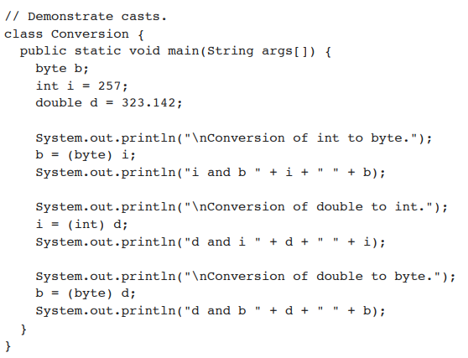
Explicit Casting
Truncation cast is also done when a float value is assigned to integer variable.
For example:

Slide 40

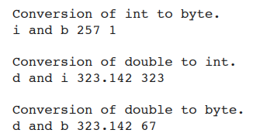
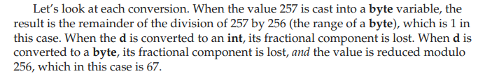
Explicit Casting

Slide 41
Casting Rules
In addition to the elevation of bytes and shorts to int, Java defines several type promotion rules that apply to expressions.
First, all byte and short values are promoted to int.
Then, if one operand is a long, the whole expression is promoted to long. If one operand is a float, the entire expression is promoted to float. If any of the operands is double, the result is double
Example

Slide 42
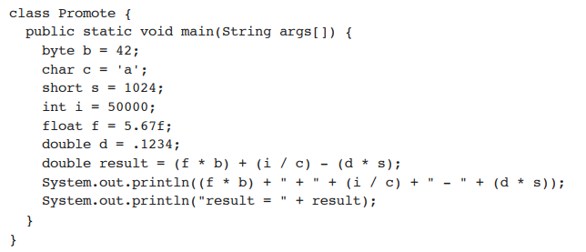
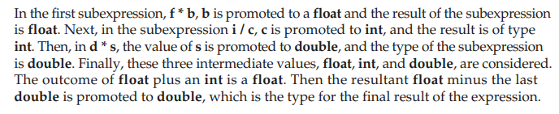
Casting Rules

Slide 43
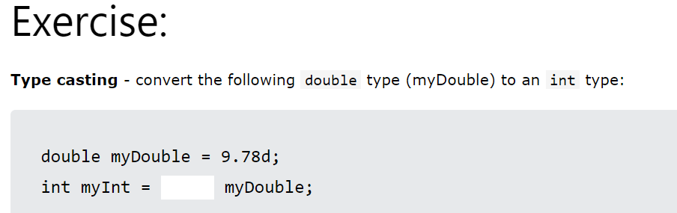
Wake up

Slide 44
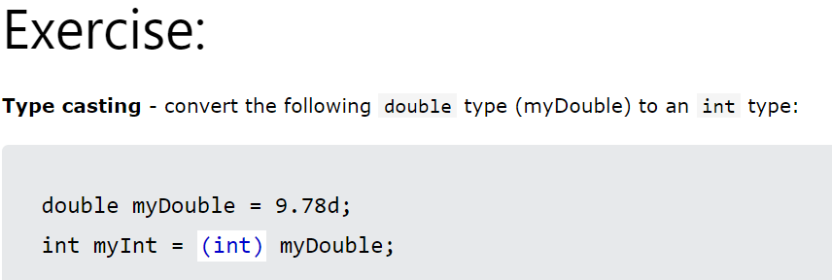
Wake up

Slide 45
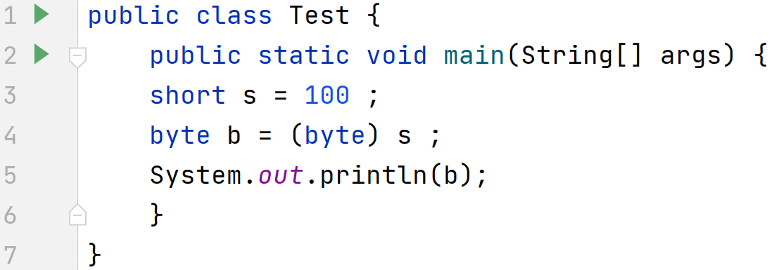
Wake up
What will be the output of the following Program?

Slide 46
Wake up
Output: 100

Slide 47
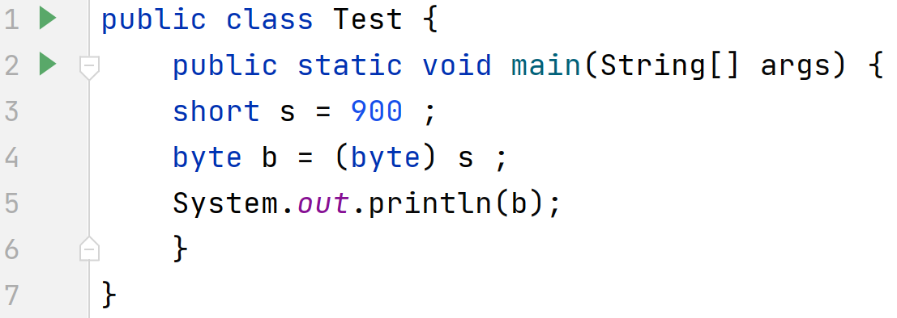
Wake up
What will be the output of the following Program?

Slide 48
Wake up
Output: -124 [Garbage value]

Slide 49
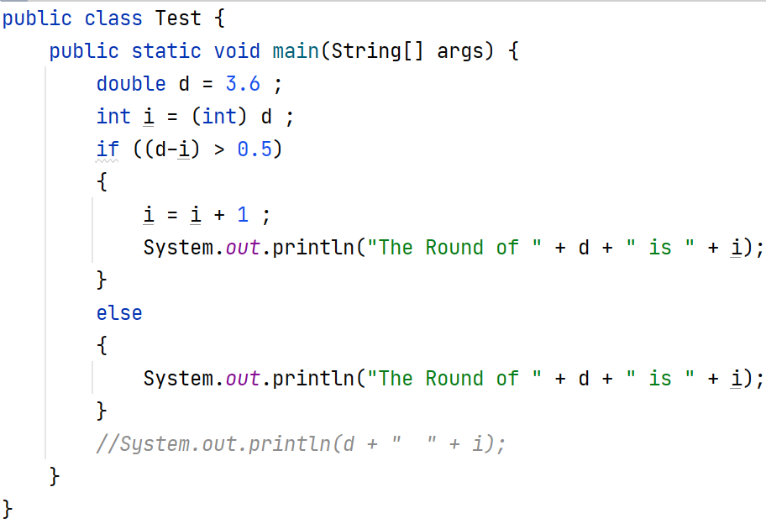
Roundoff () Logic | Example of Significance of Casting

Slide 50
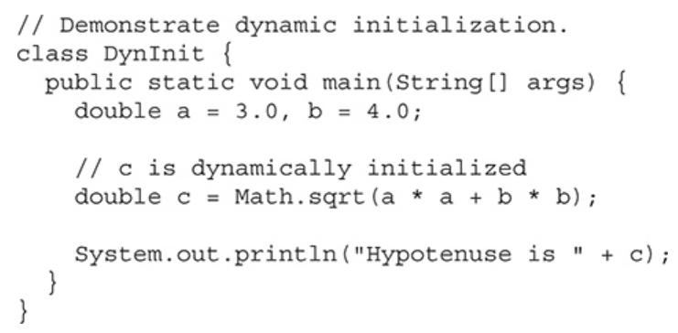
Dynamic Initiazation of Variables

Slide 51
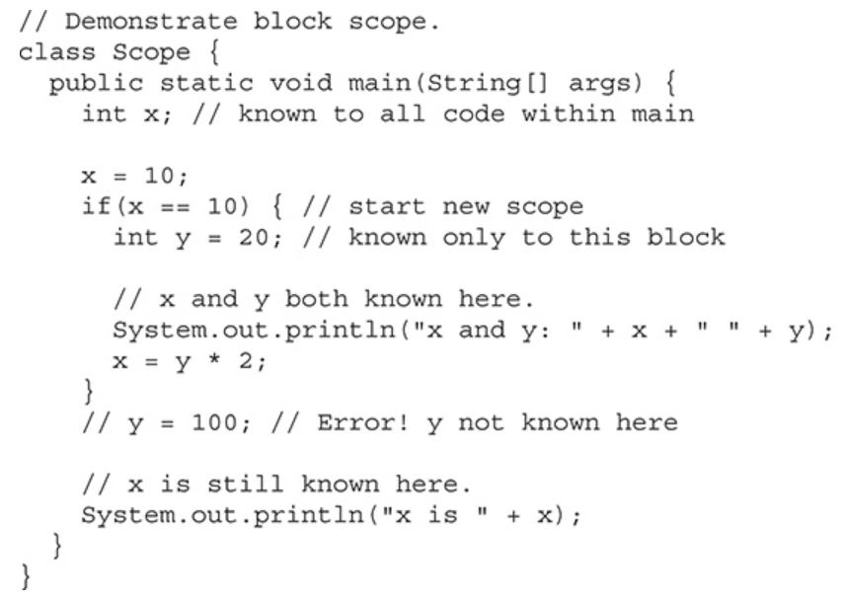
Scope of a Variables

Slide 52
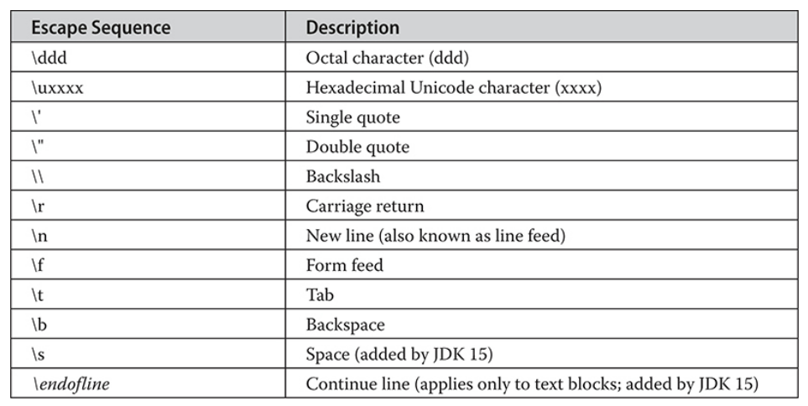
Java Escape Sequences

Slide 53
Java Comments
Single line comments
  //
Multiple line comments
  /* ….. */

Slide 54
Recap of the Lecture
Variables in Java
Datatypes in Java
Variable Naming Conventions
Java Keywords
Constant Variables
Variable Scope
Java Type Casting
Java Escape Sequences
Java Comments

